Slide 1
Design Patterns
Elements of Reusable Object-Oriented Software
Patrick Schmidt
Microsoft Certified Trainer

Slide 2
Schedule
Day 1
Introduction
Block 1
Block 2
Day 2
Block 3
Block 4
Day 3
Block 5
Block 6

Slide 3
Object Orientation
Simplified model of real-world problems
Encapsulation
Inheritance
Polymorphism
Interaction

Slide 4
SOLID
Single-responsibility principle: "There should never be more than one reason for a class to change.“ In other words, every class should have only one responsibility.
Open–closed principle: "Software entities ... should be open for extension, but closed for modification."
Liskov substitution principle: "Functions that use pointers or references to base classes must be able to use objects of derived classes without knowing it.“
Interface segregation principle: "Clients should not be forced to depend upon interfaces that they do not use."
Dependency inversion principle: "Depend upon abstractions, [not] concretions."

Slide 5
The Book Design Patterns
Creational Patterns
Defer object creation to derived classes or to another object
Structural Patterns
Patterns to compose classes or objects
Behavioral Patterns
Derivation and composition to achieve intricate f??or of control or task handling

Slide 6
Pattern structure
Name
Intent
Motivation
Applicability
Structure
Consequences.

Slide 7
Block 1
Iterator
Observer
Singleton
Visitor
Exercise 1

Slide 8
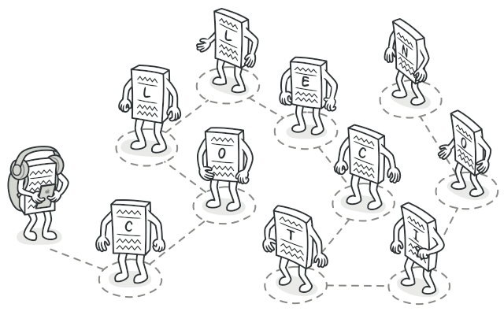
Iterator
@https://refactoring.guru

Slide 9
Iterator
Type: Behavioral Pattern
Intent: Provide a way to access the elements of an aggregate object sequentially without exposing its underlying representation.

Slide 10
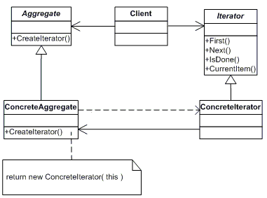
Iterator

Slide 11
Iterator
Applications
foreach statement in C#

Slide 12
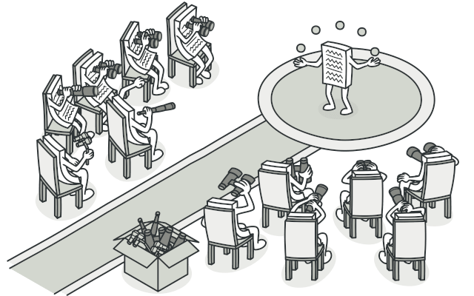
Observer
@https://refactoring.guru

Slide 13
Observer
Type: Behavioral Pattern
Intent: Define a one-to-many dependency between objects so that when one object changes, all its dependents are notified and updated automatically.

Slide 14
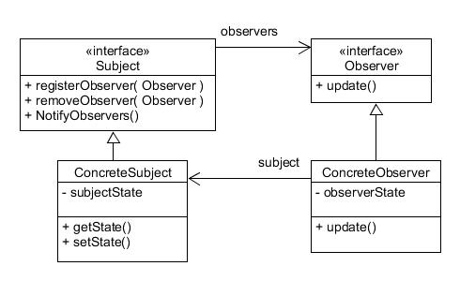
Observer

Slide 15
Observer
Applications
Change Detection mechanisms
Model View Controller (Views are observers)
Delegates (Multi cast)
RxJs

Slide 16
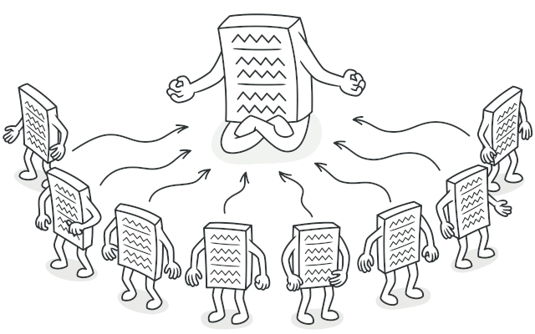
Singleton
@https://refactoring.guru

Slide 17
Singleton
Type: Creational Pattern
Intent: Ensure a class only has one instance, and provide a global point of access to it.

Slide 18
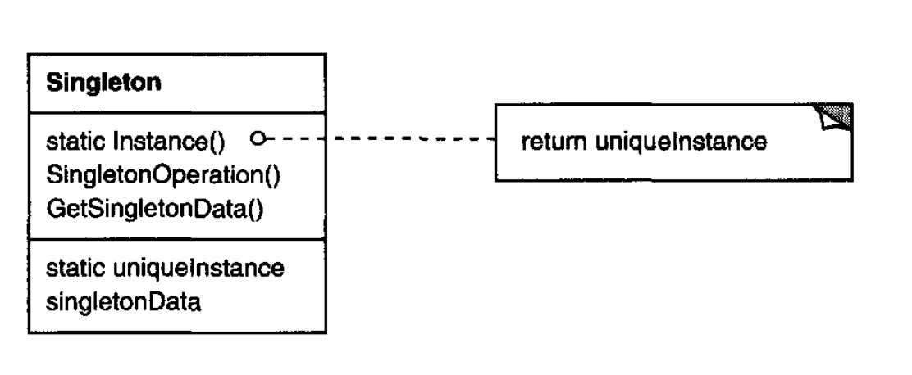
Singleton

Slide 19
Singleton
Applications
Single access to…

Slide 20
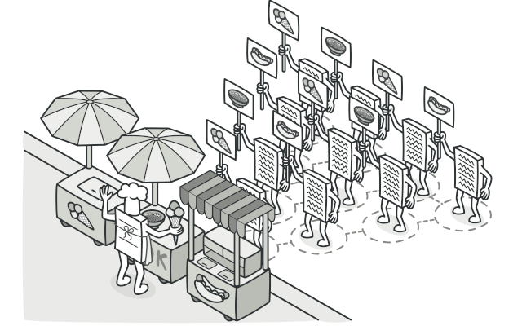
Visitor
@https://refactoring.guru

Slide 21
Visitor
Type: Behavioral Pattern
Intent: Represents an operation to be performed on the elements of an object structure. Visitor lets you define a new operation without changing the classes of the elements on which it operates.

Slide 22
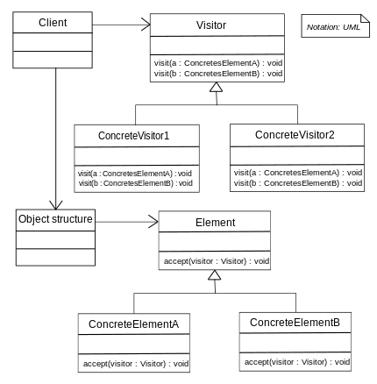
Visitor

Slide 23
Visitor
Applications

Slide 24
Exercise 1

Slide 25
Block 2
Chain of Responsibility
Mediator
Proxy
Prototype
Exercise 2

Slide 26
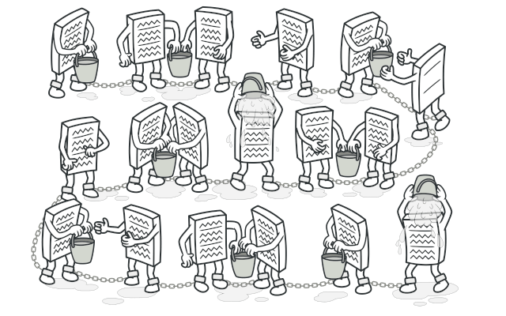
Chain of Responsibility
@https://refactoring.guru

Slide 27
Chain of Responsibility
Type: Behavioral Pattern
Intent: Avoid coupling the sender of a request to its receiver by giving more than one object a chance to handle the request. Chain the receiving objects and pass the request along the chain until an object handles it.

Slide 28
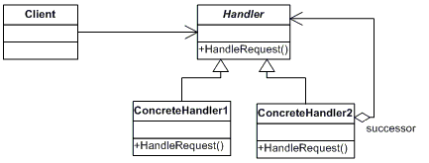
Chain of Responsibility

Slide 29
Chain of Responsibility
Applications
Help Files
Support systems
Events
Exceptions

Slide 30
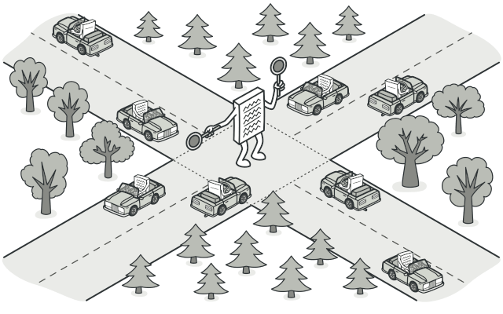
Mediator
@https://refactoring.guru

Slide 31
Mediator
Type: Behavioral Pattern
Intent: Define an object that encapsulated how a set of objects interact. Mediator promotes loose coupling by keeping objects from referring to each other explicitly, and it lets you vary their interaction independently.

Slide 32
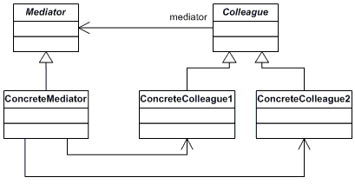
Mediator

Slide 33
Mediator
Applications
Traffic Lights
Communication between Components

Slide 34
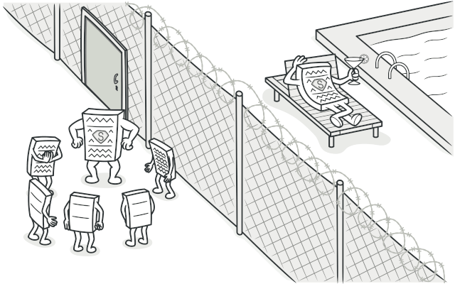
Proxy
@https://refactoring.guru

Slide 35
Proxy
Type: Structural Pattern
Intent: Provide a surrogate or placeholder for another object to control access to it.

Slide 36
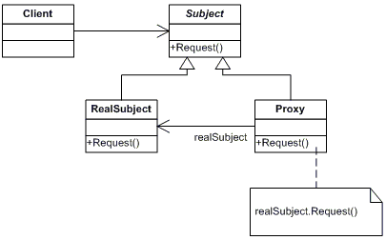
Proxy

Slide 37
Proxy
Applications
Remote Proxy like generated classes in WCF or Swagger Codegen
Lazy Loading (virtual proxies)
Protection

Slide 38
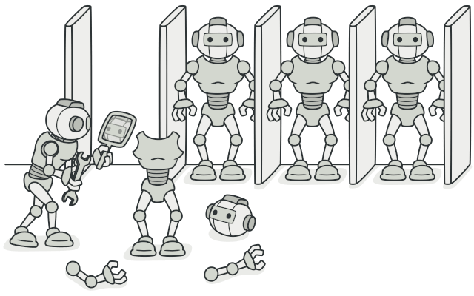
Prototype
@https://refactoring.guru

Slide 39
Prototype
Type: Creational Pattern
Intent: Specify the kinds of objects to create using a prototypically instance, and create new objects by copying this prototype.

Slide 40
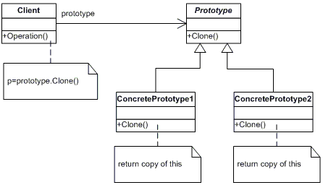
Prototype

Slide 41
Prototype
Applications
ICloneable interface

Slide 42
Exercise 2

Slide 43
Block 3
Builder
Abstract Factory
Factory Method
Composite
Exercise 3

Slide 44
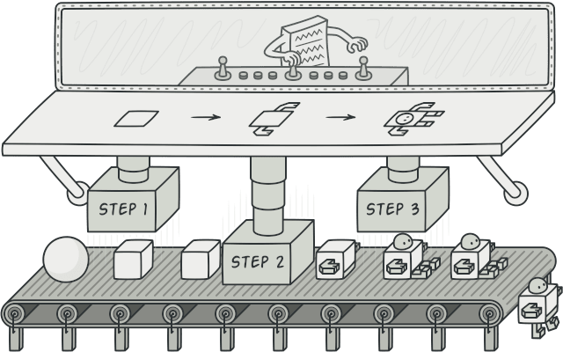
Builder
@https://refactoring.guru

Slide 45
Builder
Type: Creational Pattern
Intent: Separate the construction of a complex object from is representation so that the same construction process can create different representations.

Slide 46
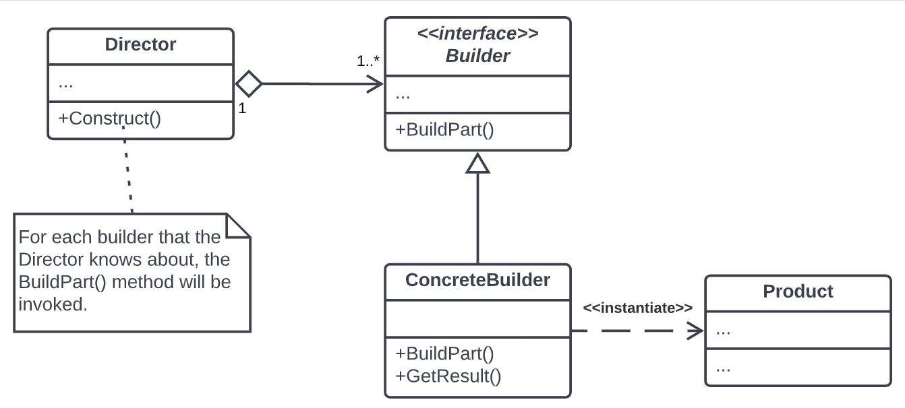
Builder

Slide 47
Builder
Applications
All kind of composite structures
(Database)Connections
Car, Houses
PublicClientApplicationBuilder, ConfidentialClientApplicationBuilder (MSAL)
ConfigBuilder

Slide 48
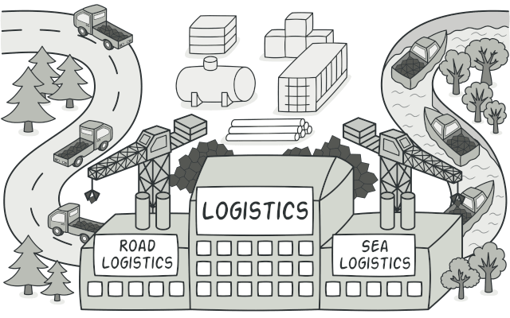
Factory Method
@https://refactoring.guru

Slide 49
Factory Method
Type: Creational Pattern
Intent: The Factory defines an interface for creating a single object, but let subclasses decide which class to instantiate.

Slide 50
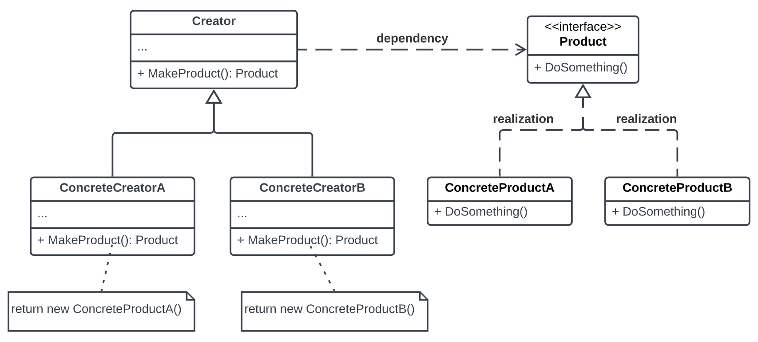
Factory Method

Slide 51
Factory Method
Applications
Transport Factory
Shape Factory
UI elements Factory

Slide 52
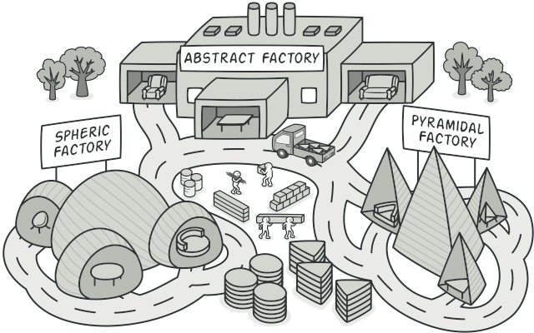
Abstract Factory
@https://refactoring.guru

Slide 53
Abstract Factory
Type: Creational Pattern
Intent: Provide an interface for creating families of related or dependent objects without specifying their concrete classes.

Slide 54
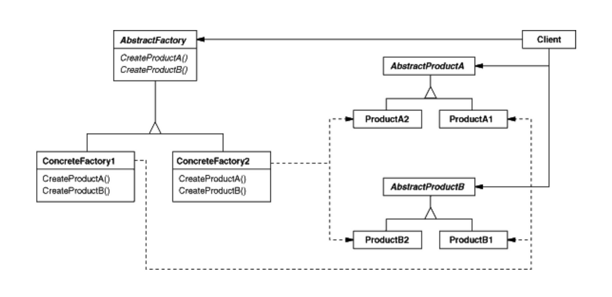
Abstract Factory

Slide 55
Abstract Factory
Applications
Car Models
UI elements Factory
Furniture

Slide 56
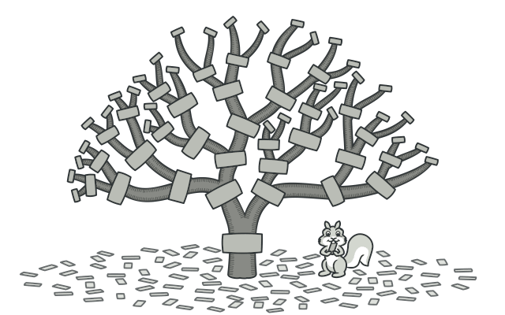
Composite
@https://refactoring.guru

Slide 57
Composite
Type: Structural Pattern
Intent: Compose objects into tree structures to represent part-whole hierarchies. Composite lets clients treat individual objects and composition of objects uniformly.

Slide 58
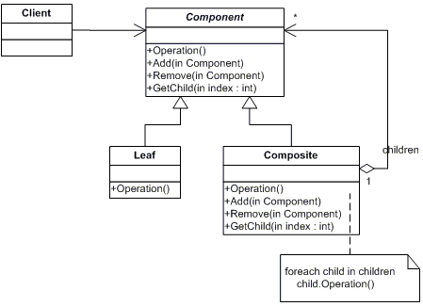
Composite

Slide 59
Composite
Applications
UI –elements (Control class in GDI+)
Bill of Materials
Order systems

Slide 60
Exercise 3

Slide 61
Block 4
Bridge
Decorator
Adapter
Exercise 4
Exercise 5

Slide 62
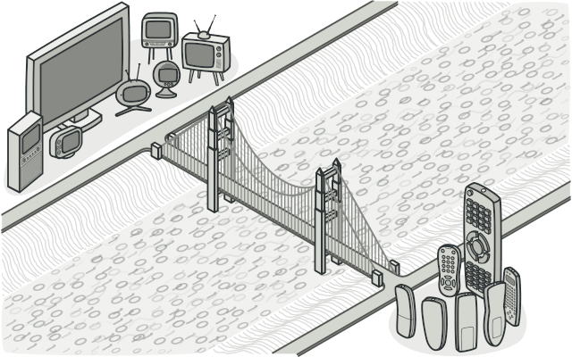
Bridge
@https://refactoring.guru

Slide 63
Bridge
Type: Structural Pattern
Intent: Decouple an abstraction from its implementation so that the two can vary independently.

Slide 64
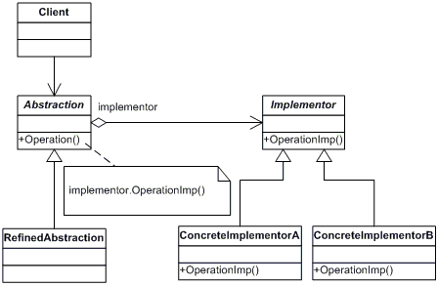
Bridge

Slide 65
Bridge
Applications
Streams and StreamReaders/Writers.
Renting types and Renting objects (boats, houses)
UI Elements and Window Types (Windows, Motif, XWindow)
Devices and Remote Controls

Slide 66
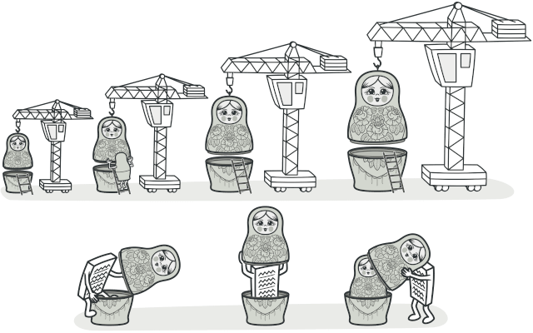
Decorator
@https://refactoring.guru

Slide 67
Decorator
Type: Structural Pattern
Intent: Attach additional responsibilities to an object dynamically. Decorators provide a flexible alternative to subclassing for extending functionality.

Slide 68
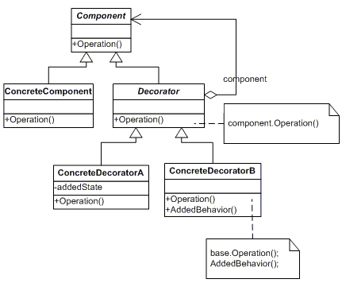
Decorator

Slide 69
Decorator
Applications
Stream (GZipStream, CryptoStream)
Beverages (Milk, Sugar, etc)
Pipeline structures (Pipeline elements add something to what streams through the pipeline)

Slide 70
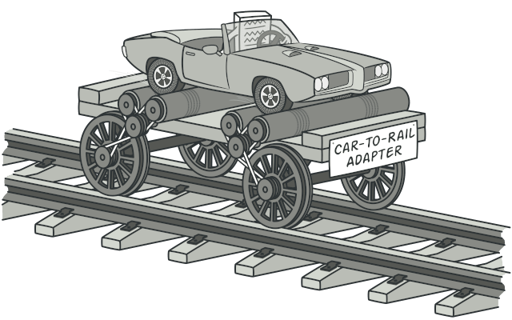
Adapter
@https://refactoring.guru

Slide 71
Adapter
Type: Structural Pattern
Intent: Convert the interface of a class into another interface client expects. Adapter lets classes work together that couldn’t otherwise because of incompatible interfaces

Slide 72
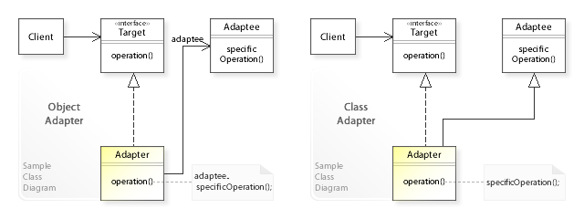
Adapter

Slide 73
Adapter
Applications
Use the Adapter class when you want to use some existing class, but its interface isn’t compatible with the rest of your code.
Use the pattern when you want to reuse several existing subclasses that lack some common functionality that can’t be added to the superclass.

Slide 74
Exercise 4 & 5

Slide 75
Block 5
Strategy
Façade
Template Method
Exercise 6
Exercise 7

Slide 76
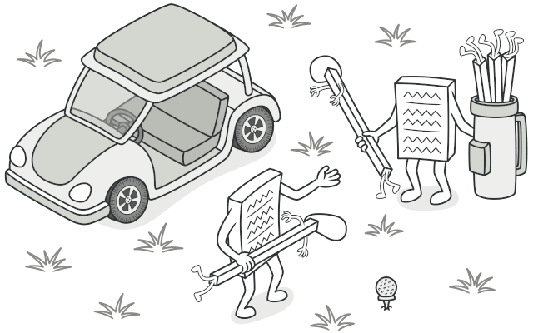
Strategy
@https://refactoring.guru

Slide 77
Strategy
Type: Behavioral Pattern
Intent: Define a family of algorithms, encapsulate each one, and make them interchangeable. Strategy lets the algorithm vary independently from clients that use it.

Slide 78
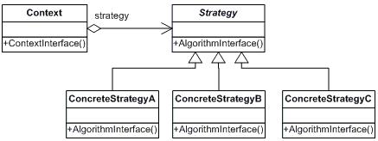
Strategy

Slide 79
Strategy
Applications
Sorting (IComparer)
Filtering (Where)
Route

Slide 80
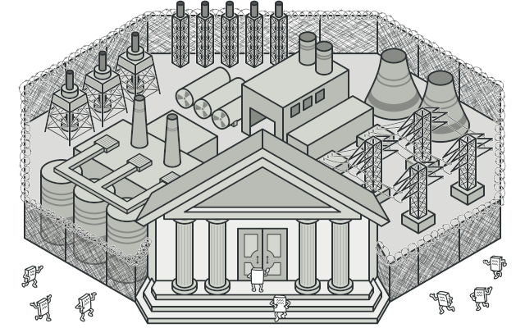
Facade
@https://refactoring.guru

Slide 81
Facade
Type: Structural Pattern
Intent: Provide a unified interface to a set of interfaces in a subsystem. Façade defines a higher-level interface that makes the subsystem easier to use.

Slide 82
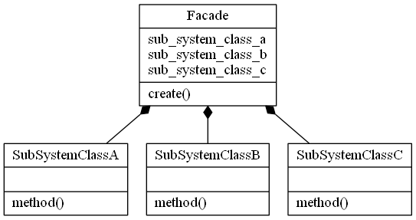
Facade

Slide 83
Facade
Applications
Use the Facade pattern when you need to have a limited but straightforward interface to a complex subsystem.
Use the Facade when you want to structure a subsystem into layers.
API Management in Azure.
Phasing out old functionality.

Slide 84
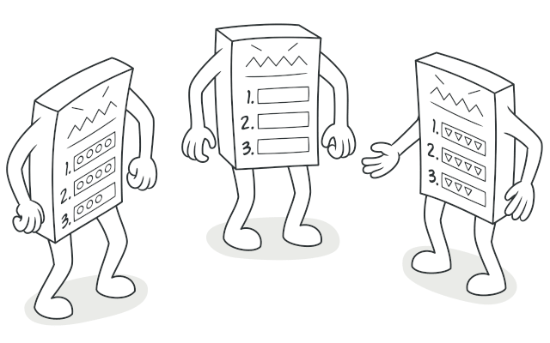
Template Method
@https://refactoring.guru

Slide 85
Template Method
Type: Behavioral Pattern
Intent: Define the skeleton of an algorithm in an operation, deferring some steps to subclasses. Template Method lets subclasses redefine certain steps of an algorithm without changing the algorithm’s structure.

Slide 86
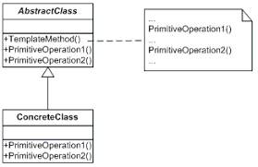
Template Method

Slide 87
Template Method
Applications
Form classes with OnLoad, OnInit, OnDestroy etc.
Data Mining (Defer interpretation of the data. XML, CSV etc)

Slide 88
Exercise 6 & 7

Slide 89
Block 6
State
Command
Memento
Flyweight
Exercise 8

Slide 90
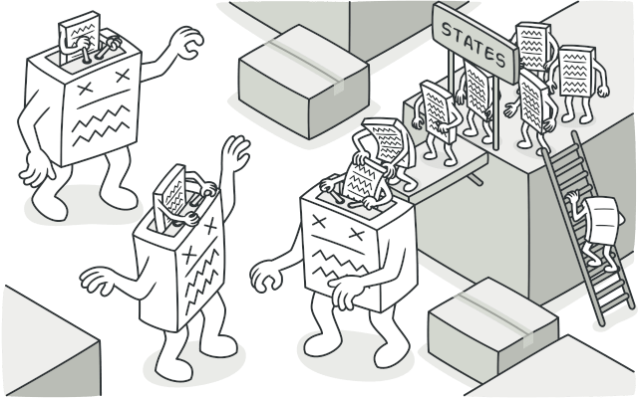
State
@https://refactoring.guru

Slide 91
State
Type: Behavioral Pattern
Intent: Allow an object to alter its behavior when its internal state changes. The object will appear to change its class.

Slide 92
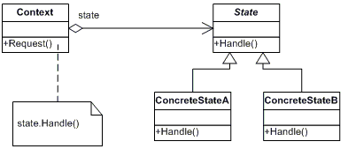
State

Slide 93
State
Applications
Documents (Create, Review, Publish states)
Video, Audio
async
Messaging Apps (Idle, Busy, Away)
OS (Starting, Running, Terminating)

Slide 94
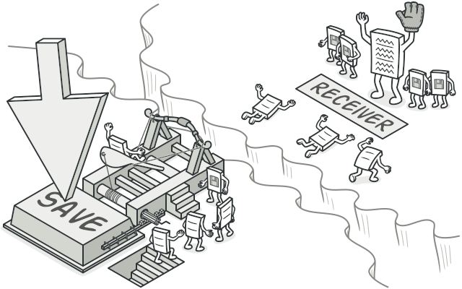
Command
@https://refactoring.guru

Slide 95
Command
Type: Behavioral Pattern
Intent: Encapsulate a request as an object, thereby letting you parameterize clients with different requests, queue or log requests, and support undoable operations.

Slide 96
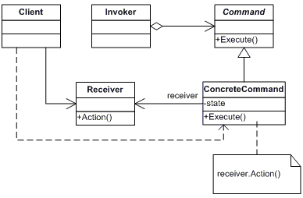
Command

Slide 97
Command
Applications
UI Commands (Save, Undo etc)
WPF (ICommand)

Slide 98
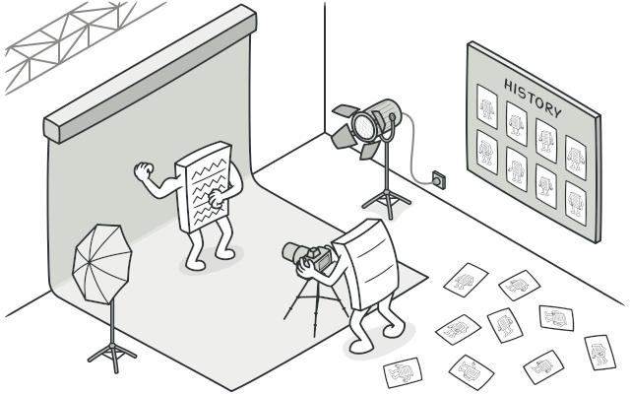
Memento
@https://refactoring.guru

Slide 99
Memento
Type: Behavioral Pattern
Intent: Without violating encapsulation, capture and externalize an object’s internal state so that the object can be restored to this state later.

Slide 100
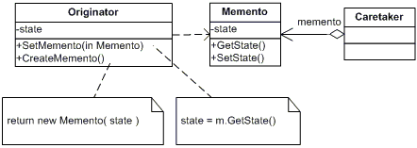
Memento

Slide 101
Memento
Applications
Shapshots of objects (parts)

Slide 102
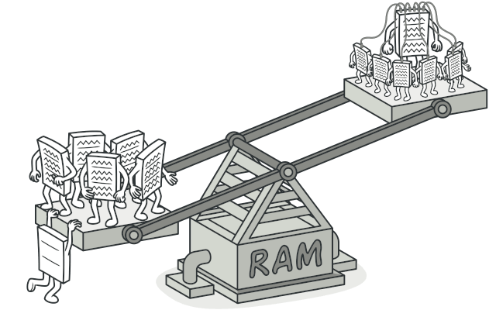
Flyweight
@https://refactoring.guru

Slide 103
Flyweight
Type: Structural Pattern
Intent: Use sharing to support large numbers of fine-grained objects efficiently.

Slide 104
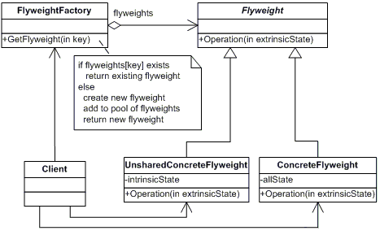
Flyweight

Slide 105
Flyweight
Applications
Use the Flyweight pattern only when your program must support a huge number of objects which barely fit into available RAM.
Graphical Text Processing (characters)
Games (surrounding elements)
Any reusing system where references doesn’t matter (atomic object does not change)

Slide 106
Exercise 8

